Slide 1
Robot Vision Phase 2
Thomas Kong and Amolak Plaha

Slide 2
Main Topics Used in Phase 2:
Camera Calibration
Masking Image
ARUCO Detection
ORB Feature Detection
Notes:
The main topics implemented in phase 2 are camera calibration, masking image, ARUCO detection and ORB feature detection.

Slide 3
Similarities to Phase 1:
Measure Object in 2D image
Uses Camera Calibration
Use Aruco Detection
Notes:
In phase 1, we utilized the method of measuring objects in 2d, camera calibration, and ARUCO detection.

Slide 4
New Features in Phase 2:
Uses only one image for Measurement
Can identify objects in image
Can measure multiple objects in image
Notes:
The changes made to the next phase is seen here. In phase 2, we used camera calibration and a termination criteria to get the point for measurement. Next, masking was used to to identify each image respectively and name them appropriately to a penny, nickel, dime, and quarter. Aruco and apriltag was then utilized to detect one tag and convert the coordinates to integers. A binding box was drawn for visual purposes using Aruco.

Slide 5
Basic Procedure:
Code performs camera calibration for distortion coefficients and k matrix
Take image input for measurement and finds Aruco Marker in image
Use Aruco Marker as reference for measurement (must know Marker’s length)
Perform masking to find contours within image and create bounding box for each notable figure
Notes:
Taking images of checkered boards so that we can calibrate the cameras for the distrotaion coefficients

Slide 6
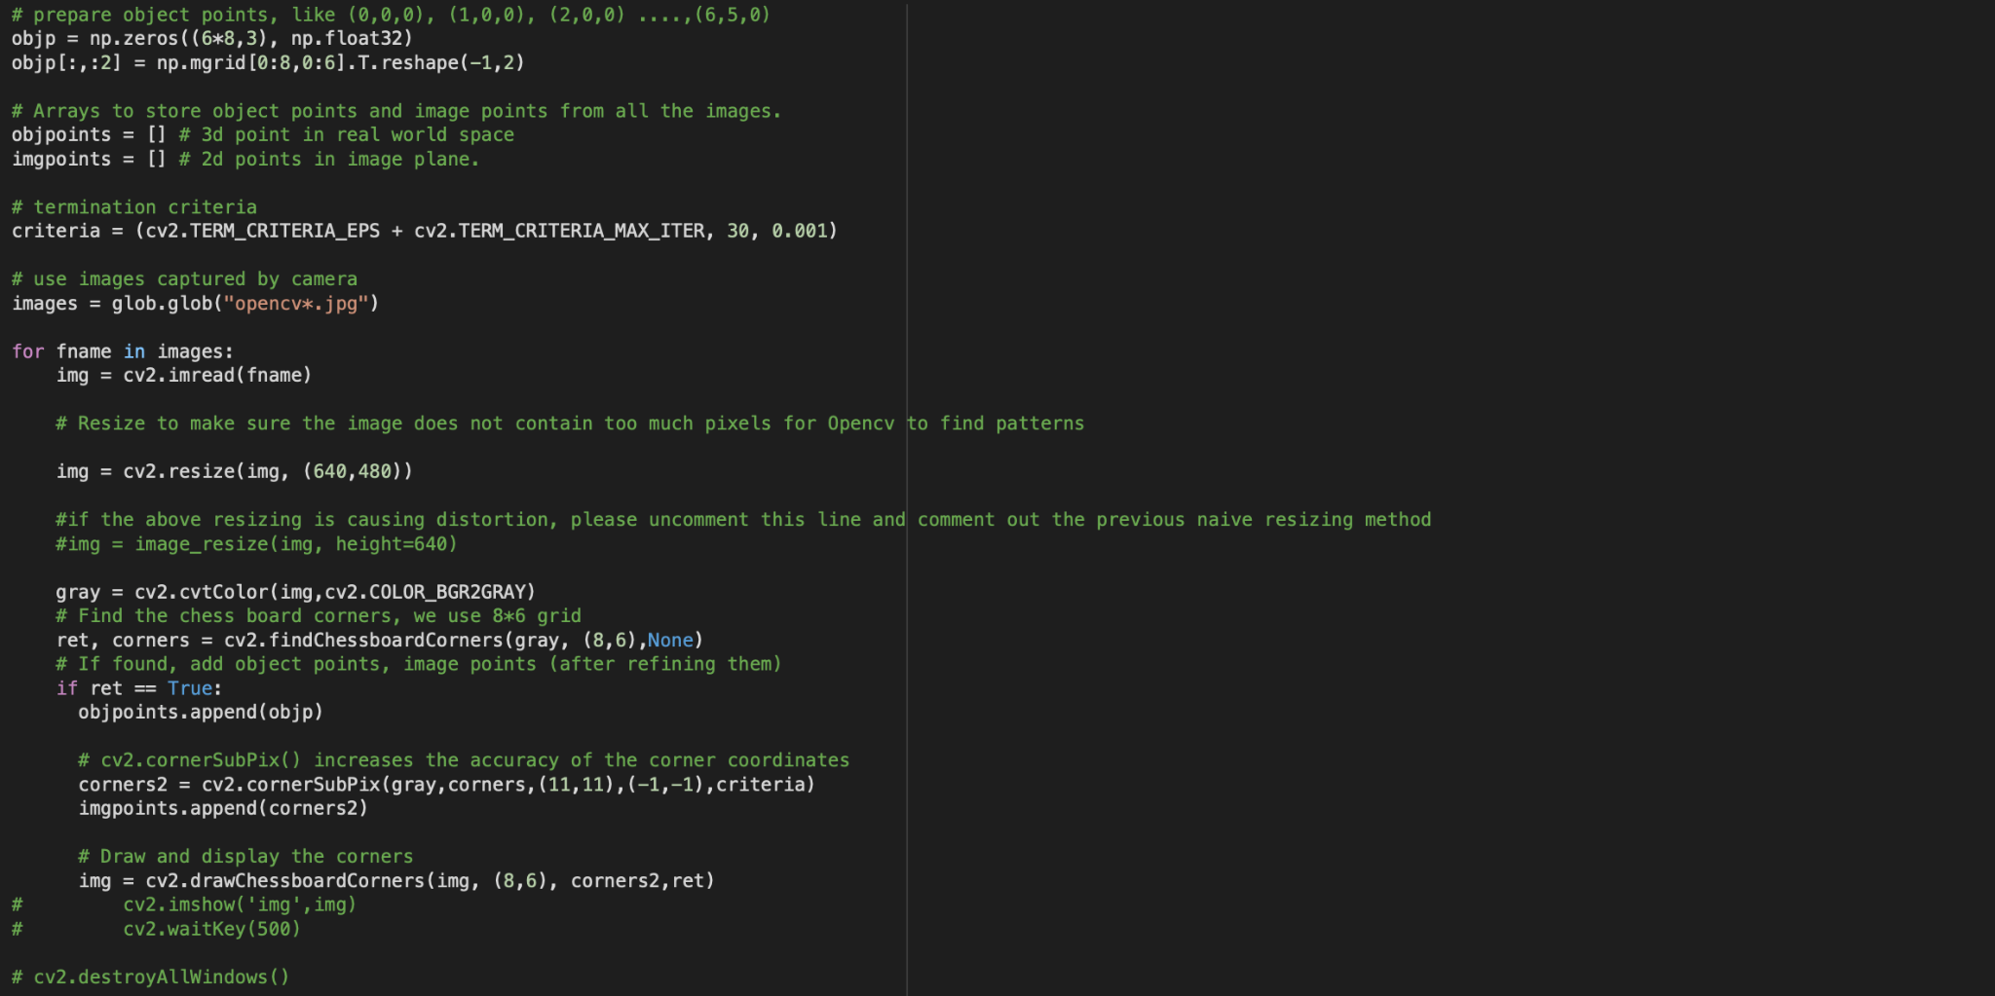
Notes:
Code performs camera calibration for distortion coefficients and k matrix

Slide 7
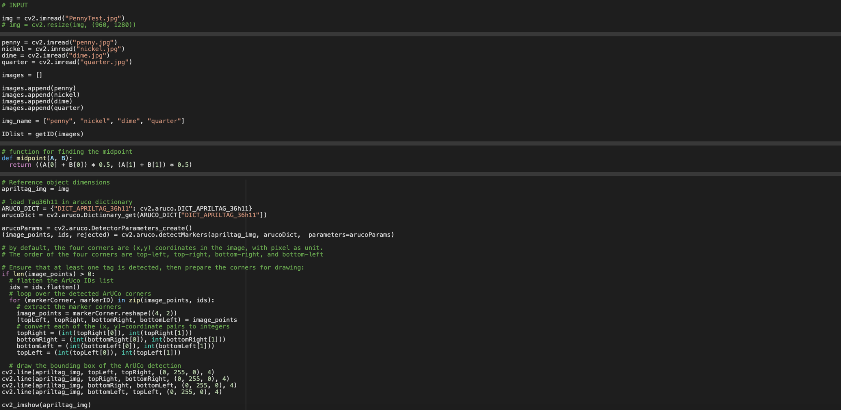
Notes:
Detecting the marker and highlighting it for visualizing puroposes

Slide 8
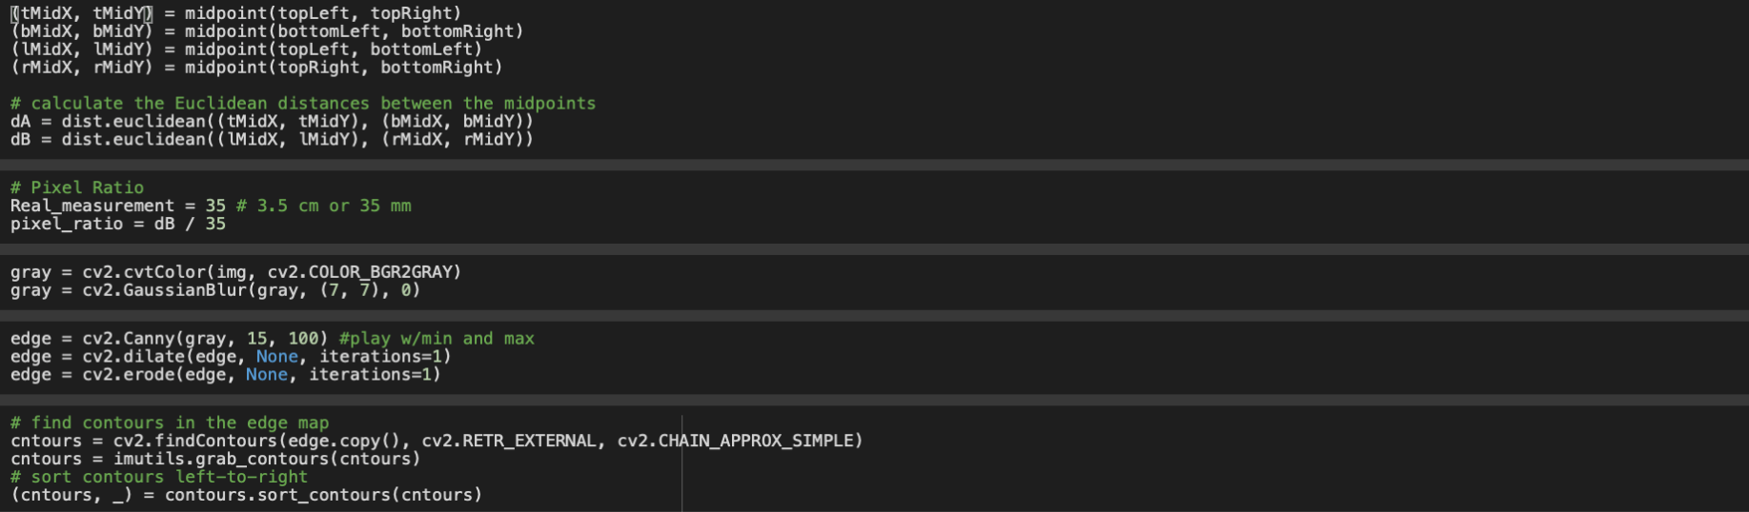
Notes:
Taking the measurements of the marker and using the distance of pixels from one corner to another data. Then the distance of the pixel is converted to milimeter. The images are being masked.

Slide 9
Basic Procedure:
For each bounding box, find length and width of each box to find object’s dimension based on reference measurements
Create new image by cropping each bounding box
Use Orb Detection on crop image and compare it to list of inputted images
Image that best matches crop image is that object’s “Identity”
Write object’s identity on original image

Slide 10
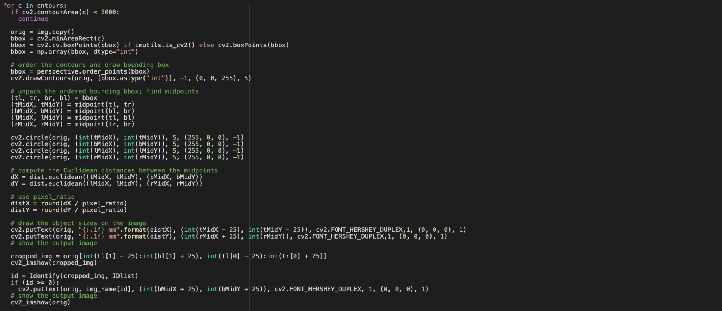

Slide 12
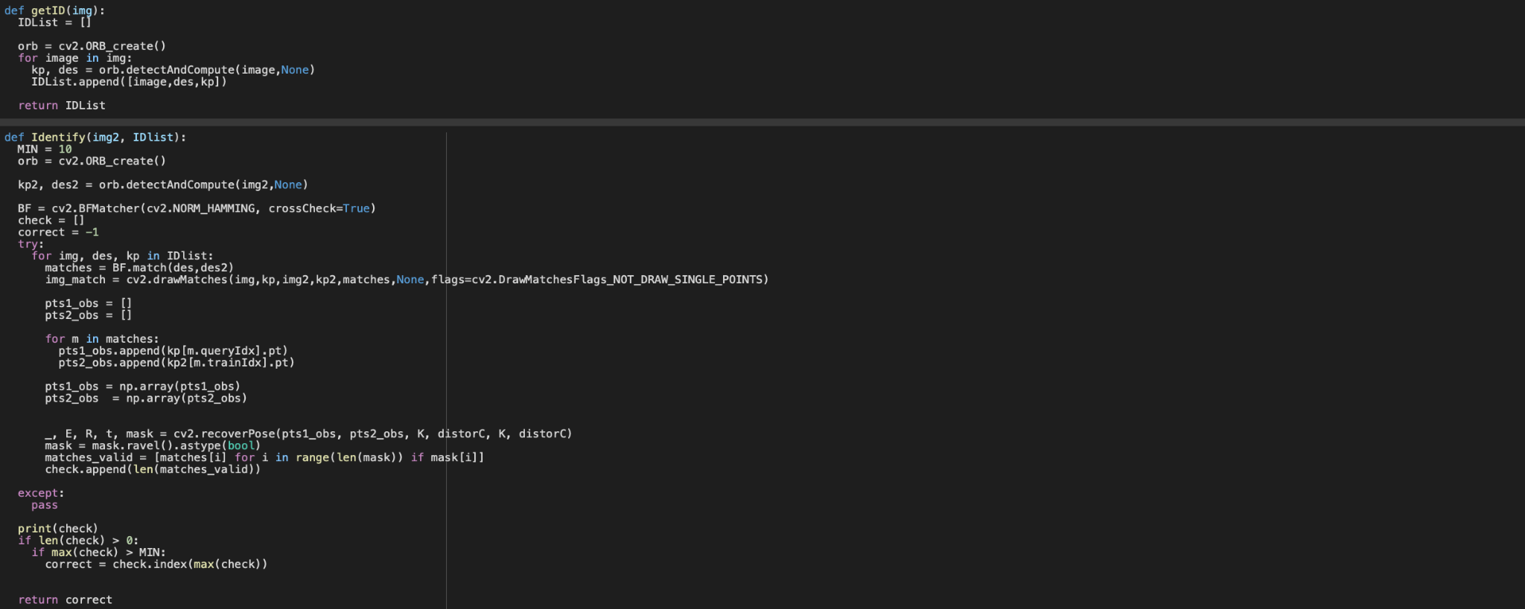

Slide 13
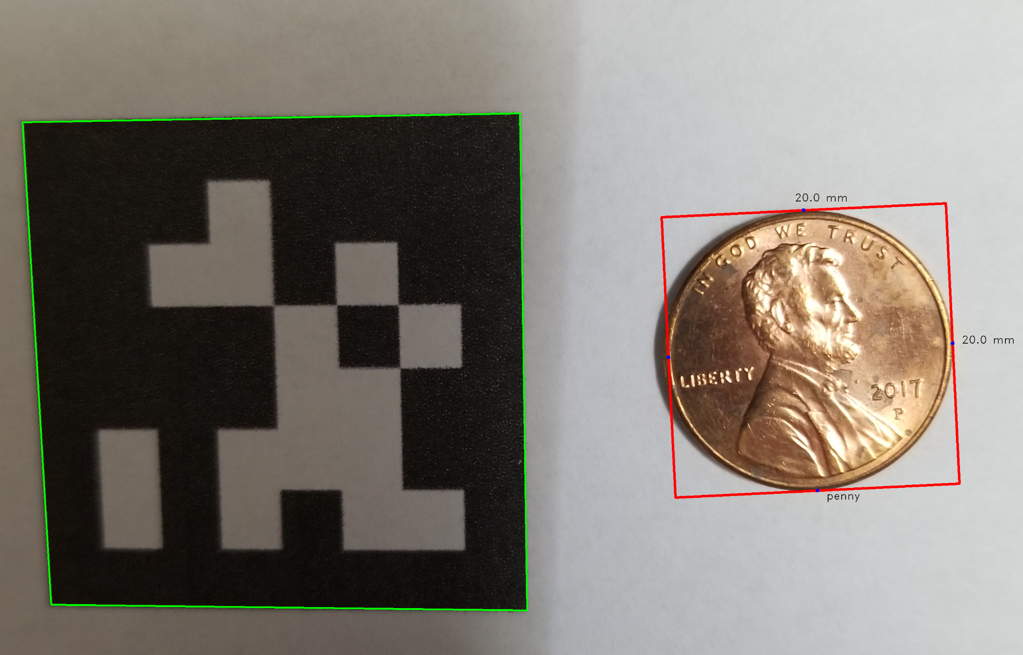
Results:
Image shows an Aruco Marker and a Penny
Marker’s length is 3.5 cm or 35 mm
Typical Penny’s length and width are 19 mm (some error)

Slide 14
Results for image with many objects:
Notes:
Input list of images for ORB detection does not include Dollar bill or Aruco Marker so no ID output is shown for them in the bottom of object

Slide 15
Limitations:
Image should have white background for better output
Difficulty measuring Height of an object
Images used for ORB feature must be clear
Some error in measurements and in detection

Slide 16
Conclusion:
Output for Identification heavily depends on input images
Code can be improved in terms of ORB detection and Measurement
Possible to adapt code to work with video rather than image
Notes:
Quality and background color
ORB detection and measurement can be used to improve code

Slide 17
Contributions
Both Thomas and Amolak brainstormed/ contributed to the ideas to make phase 1 more automated.
Thomas focussed on the physical coding aspect of the project.
Amolak focussed on the slides and drawing connections between phase 1 and 2.

Slide 18
Thank you!

